Slide 1

课时练习
模块五 第一章 第二节

Slide 2
一、翻译下列词组。
1. 似乎有点不开心 __________________________
2. 看电影 __________________________________
3. 为……感到难过 __________________________
4. 听起来很优美 ____________________________
seem a little unhappy
see the movie/film
feel sorry for …
sound wonderful

Slide 3
二、根据语境、音标或所给单词的提示完成句子， 每空一词。
1. He found life in the small town a little ________ (bore).
2. Many musicians borrow singing skills from Beijing ________ /'ɒprə/.
3. Young people are becoming more and more __________ (interest) in red tour(旅游).
boring
Opera
interested

Slide 4
二、根据语境、音标或所给单词的提示完成句子， 每空一词。
4. Many people ________ /siːm/ to feel they cannot stop looking at their phones all the time.
5. I have two tickets ______ the concert. Would you like to go with me?
seem
to

Slide 5
三、单项选择。
( )1. —What do you think of choudoufu?
—It smells bad but _______ good.
A. looks B. tastess C. feels
B

Slide 6
三、单项选择。
( )2. Ann will not be able _______ your birthday party because she has a temperature.
A. to come B. come to C. to come to
C

Slide 7
三、单项选择。
( )3. —_______ do you like the show?
—I like it a lot. It’s so funny.
A. What B. Why C. How
C

Slide 8
三、单项选择。
( )4. I am _______ to move to Shanghai and live in such a big and _______ city.
A. exciting; excited B. excited; exciting
C. excited; excited
B

Slide 9
三、单项选择。
( )5. It’s necessary to get a vaccine(疫苗), ________ the COVID-19 is still spreading(传播).
A. because B. so C. but
A

Slide 10

四、看图写话。
1. turn, autumn
The leaves turn yellow/brown in autumn.

Slide 11
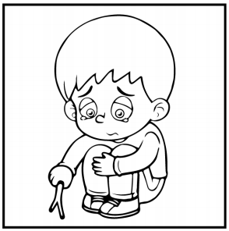
四、看图写话。
2. seem
The boy/He seems sad/unhappy.

Slide 12
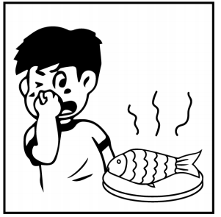
四、看图写话。
3. terrible
The fish smells terrible.

Slide 13
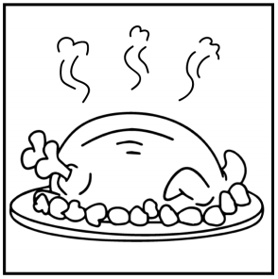
四、看图写话。
4. taste
The chicken tastes delicious/good.

Slide 14

四、看图写话。
5. interested
The girl/She is interested in cooking.

Slide 15


